Slide 1
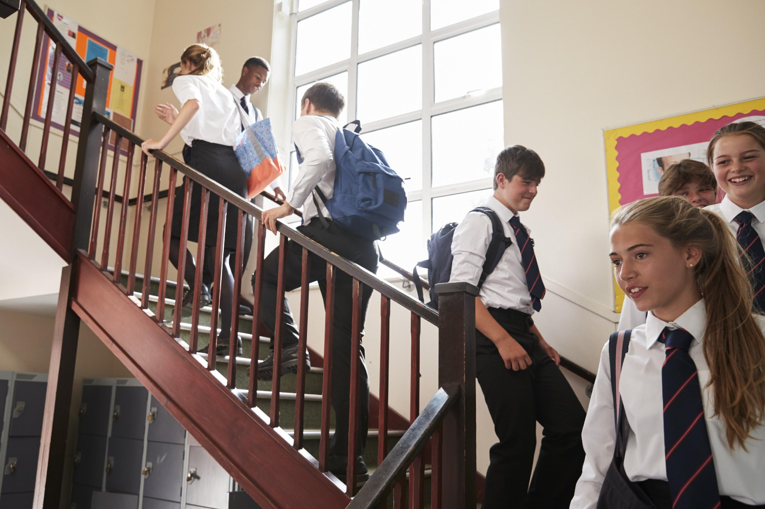

Pupil Voice: The key to creating smarter working and safer communities

Slide 2
Our aims
Build on the outstanding safeguarding work that happens in your organisations
Place young people at the centre of safeguarding strategies
Facilitate the work that you do in your communities
Provide opportunities for young people to engage with their communities

Slide 3
The Challenges that Schools and Local Authority Partners Face
Doing The Right Thing For Our Children
Do The Right Thing For Our Organisation
Know our communities are safe
Know the safeguarding issues our young people really face
Know our safeguarding interventions are effective
Evidence that KCSIE and Working Together to Safeguard Children are active documents in our settings
Compliance with inspection frameworks
Limited Time and Resources

Slide 4
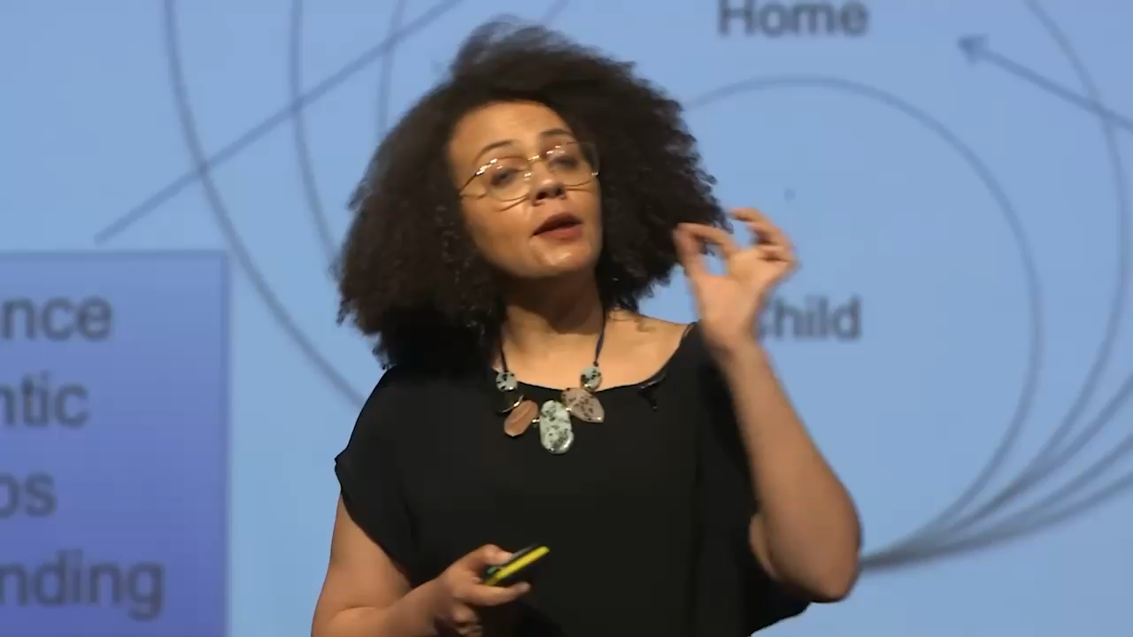
Contextual safeguarding – the key to working smarter?

Slide 5
Contextual safeguarding – the key to working smarter?
Develop Community
Contextual safeguarding does not just focus on one individual, but on how to protect all young people from environments that cause safeguarding issues. It uses partnerships between educational settings and communities so that everyone is aware of possible warning signs and how to report them.
Develop a Shared Culture of Safety
All those who have influence over extra-familial contexts use their influence to make these settings safer. As a result, young people are protected by ensuring that the potential for harmful situations is reduced.
Age Appropriate
Contextual safeguarding is particularly important for adolescents because as young people age, they spend more time socialising away from their families. Consequently, their social networks – and any harm associated with them – become more significant.
Prevent Future Harm
The relationships that young people make during this period of time influence what they expect from future relationships, so if they socialise in safe, supportive environments then they will form safe, supportive relationships (and the same applies for harmful, abusive relationships). By ensuring that young people are in nurturing environments – both within educational settings, and outside them – you can reduce the risk of future harm.

Slide 6
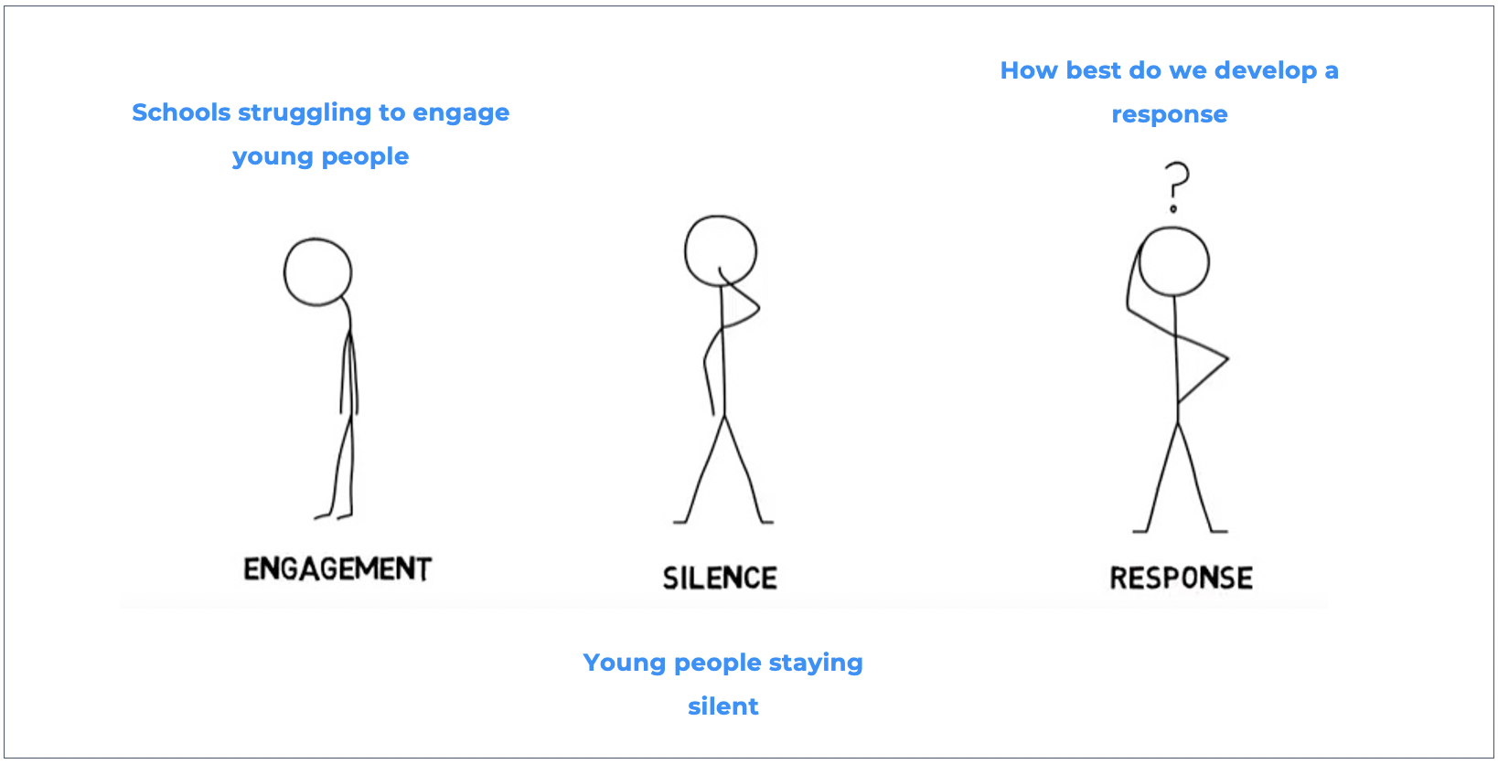
The challenge -Dr Firmin (2017)

Slide 7

Our guiding principle
“We will not understand the everyday life experiences of young people unless we seek to understand the social rules that govern their lives.”
(Dr Carlene Firmin, 2021)

Slide 8
Authentic student voice can develop more meaningful contextual responses
Measure your outcomes
Provide brave spaces for young people and children to share information on their terms
Guiding Principle:
Understand the social rules that govern young lives
Partner with your community to develop positive outcomes for your community
Seek to understand the information shared

Slide 9
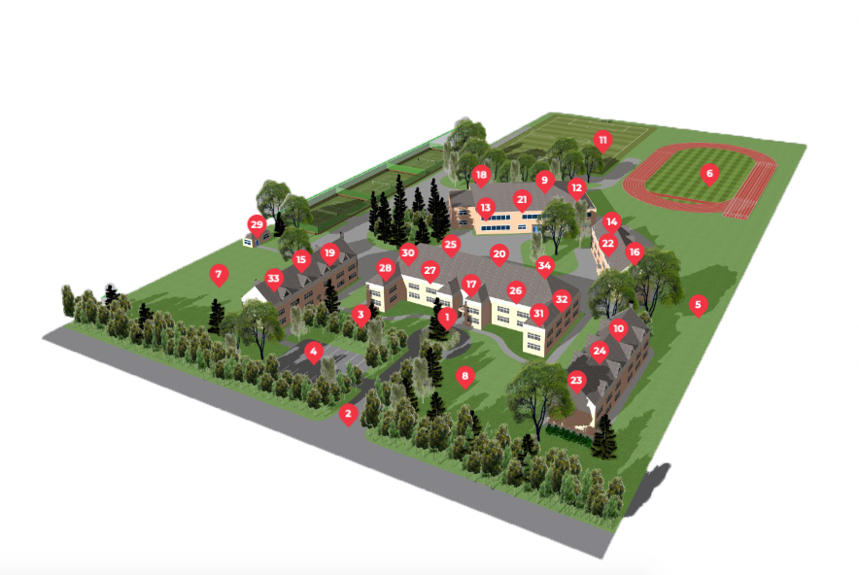
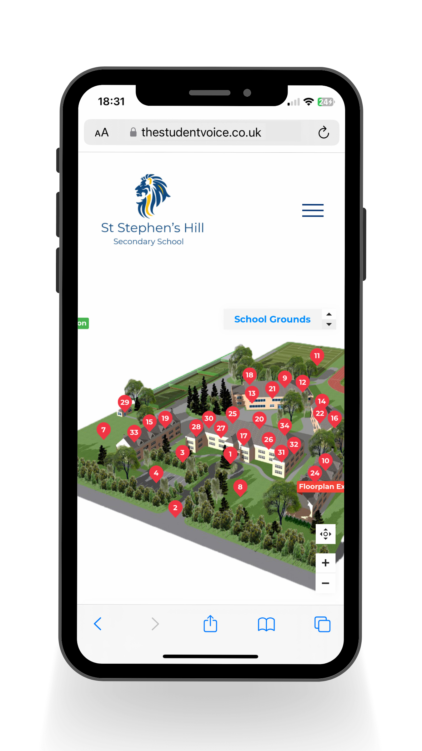
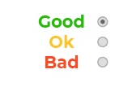
Provide brave spaces for young people and children to share information on their terms
Target – Identify, assess, and intervene with the social conditions in which harm is taking place.
Traffic Light Reporting
How safe do you feel here?

Slide 10
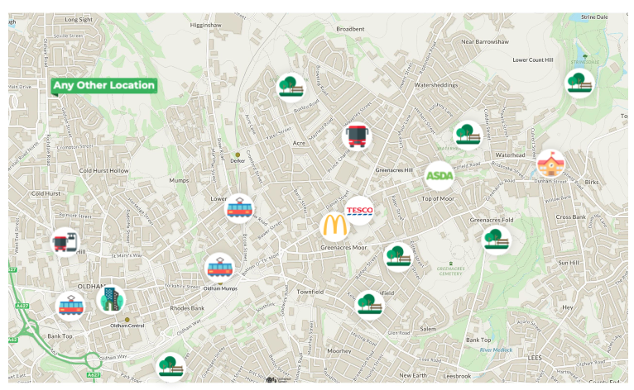
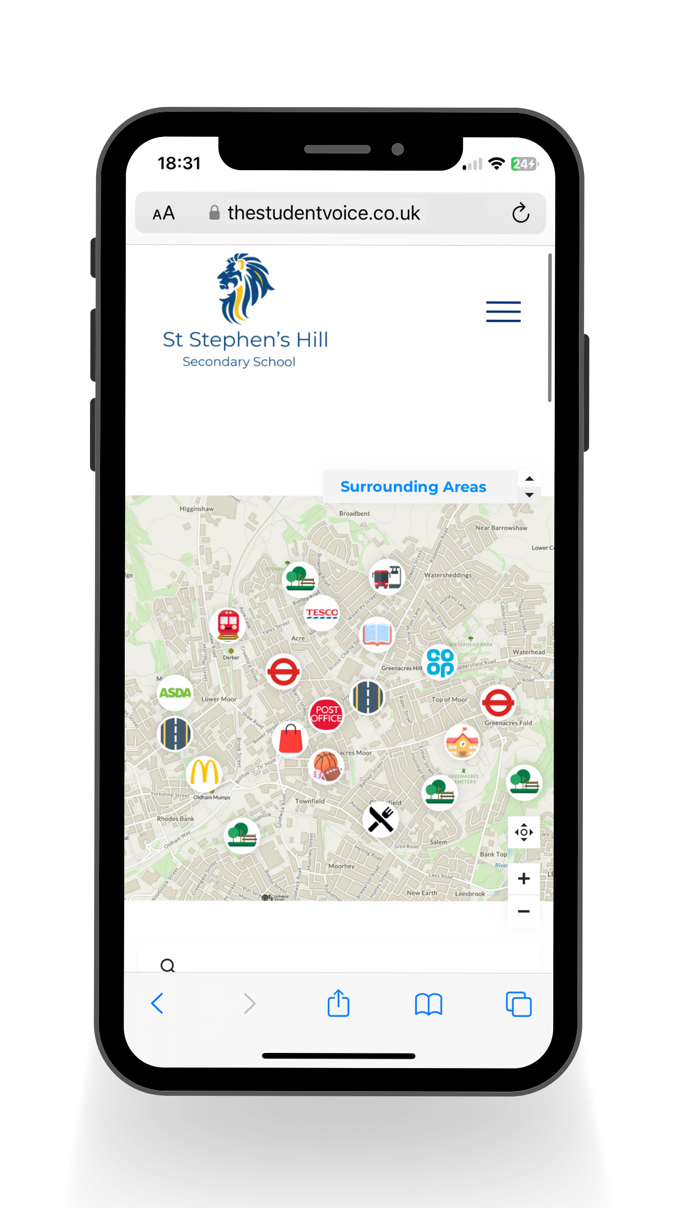
Provide brave spaces for young people and children to share information on their terms
Target – Identify, assess, and intervene with the social conditions in which harm is taking place.
Traffic Light Reporting
How safe do you feel here?

Slide 11
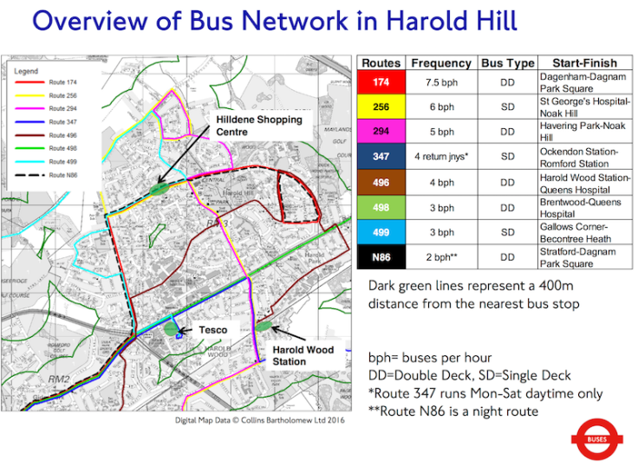
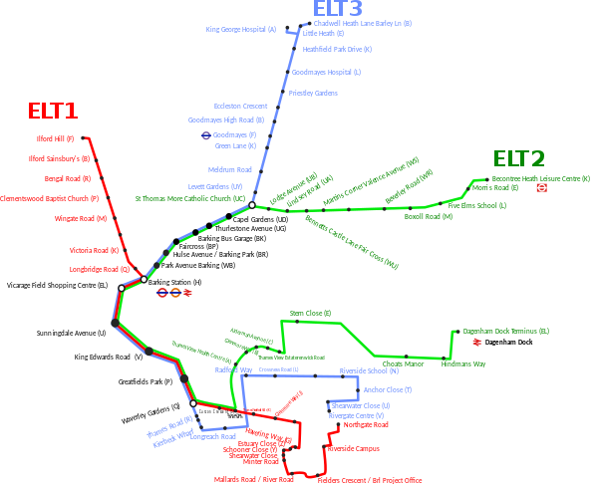
Provide brave spaces for young people and children to share information on their terms
Target – Identify, assess, and intervene with the social conditions in which harm is taking place.
Traffic Light Reporting
How safe do you feel here?

Slide 12
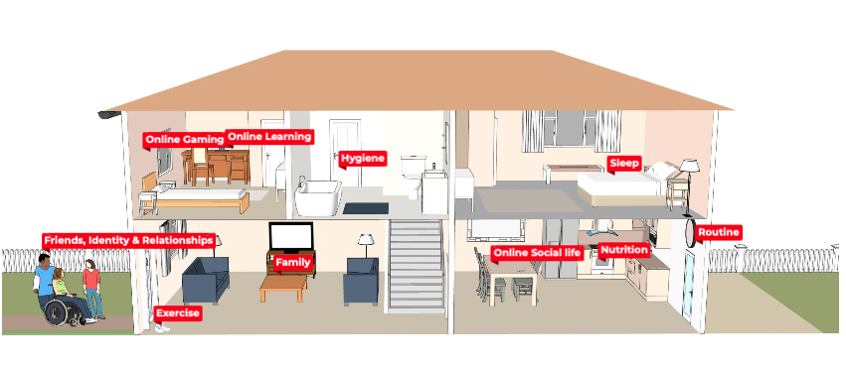
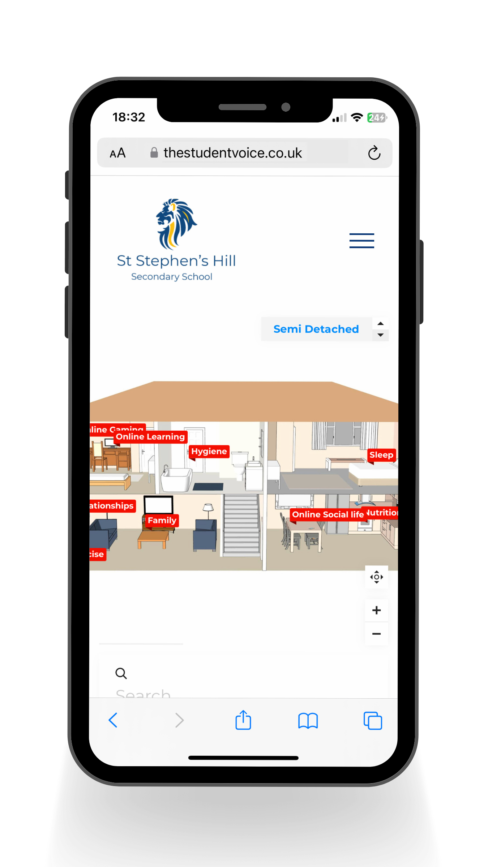
Provide brave spaces for young people and children to share information on their terms
Target – Identify, assess, and intervene with the social conditions in which harm is taking place.
Traffic Light Reporting
How safe do you feel here?

Slide 13
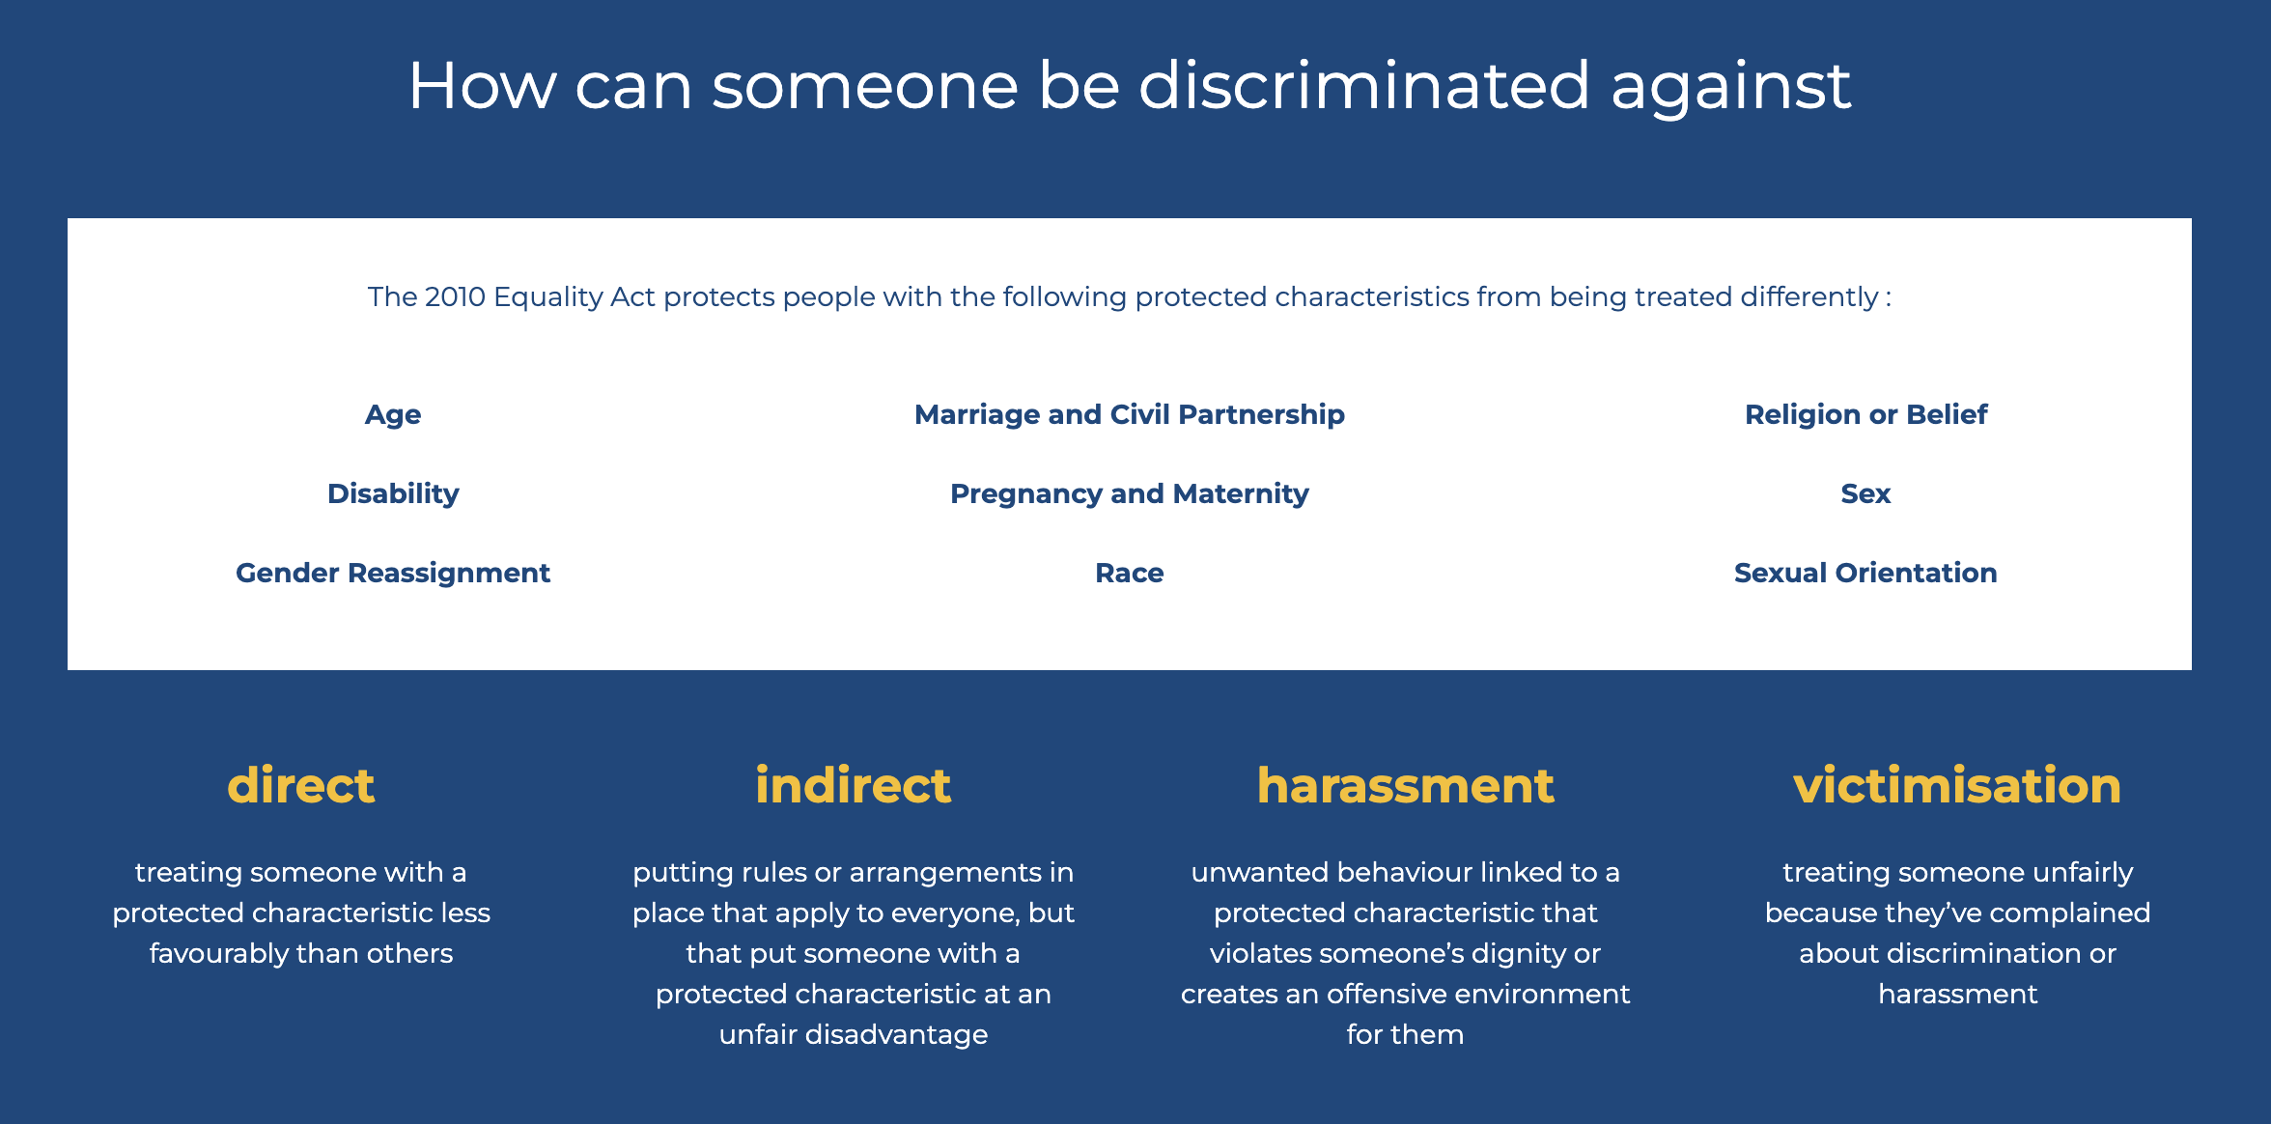
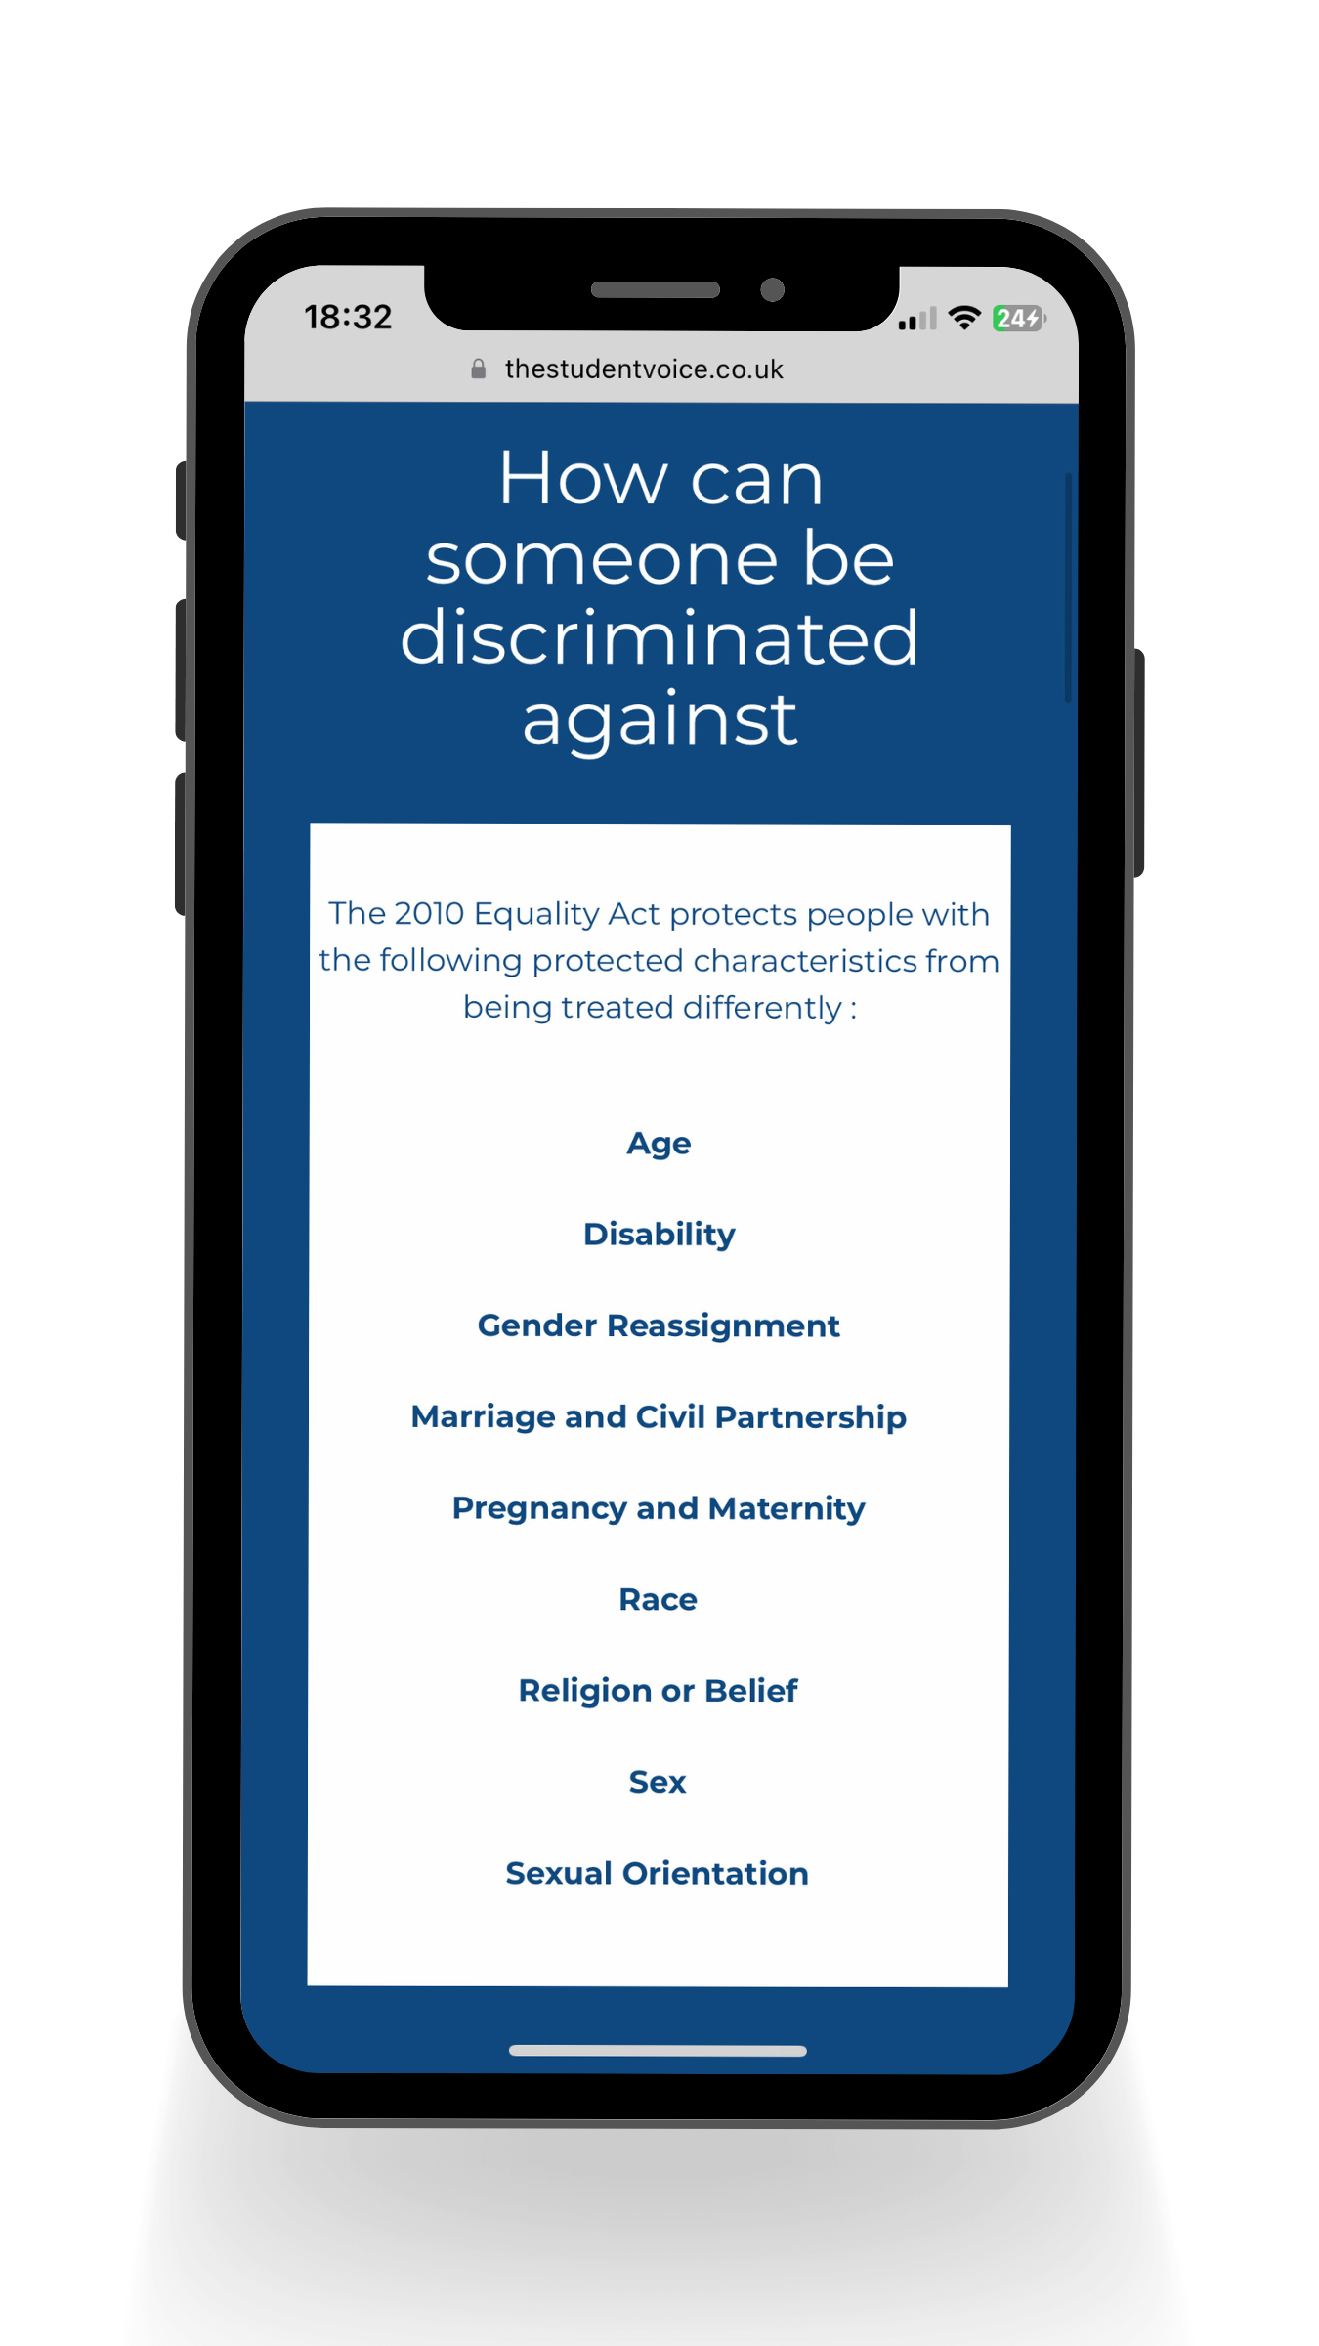
Provide brave spaces for young people and children to share information on their terms
Target – Identify, assess, and intervene with the social conditions in which harm is taking place.

Slide 14
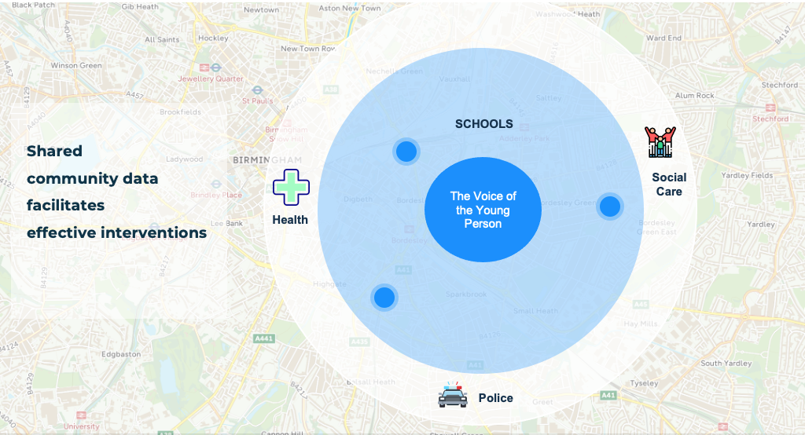
Partner with your Community

Slide 15
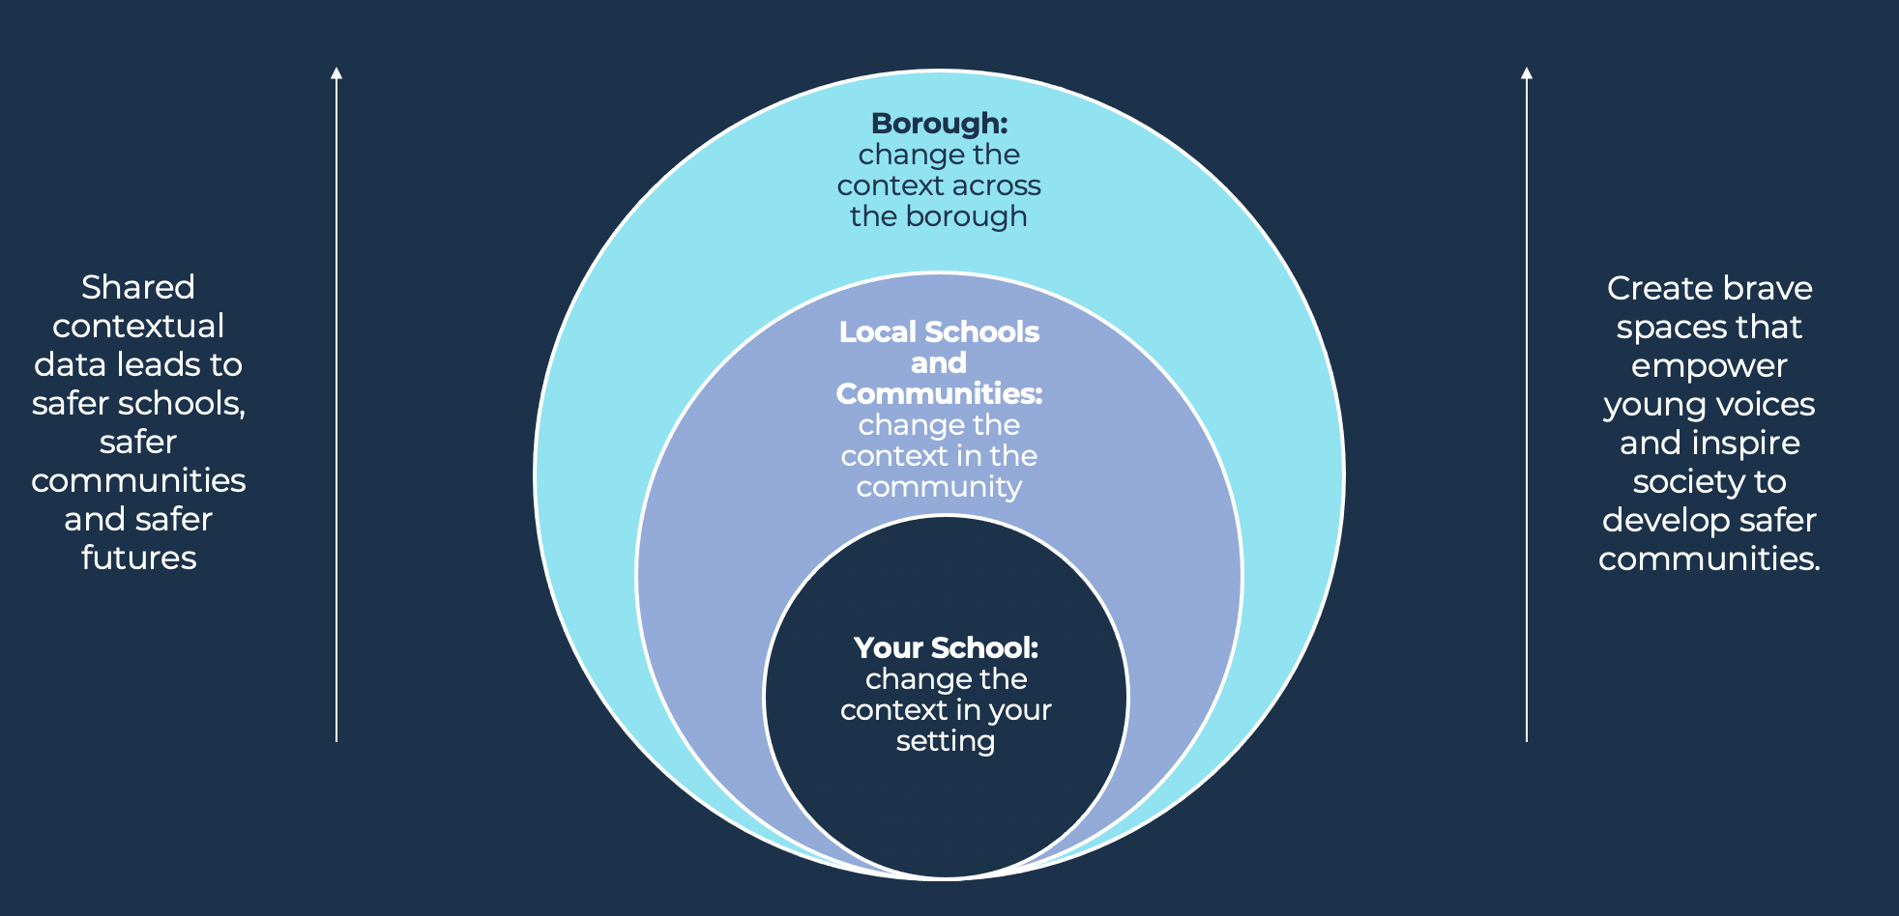
Partner with your Community

Slide 16
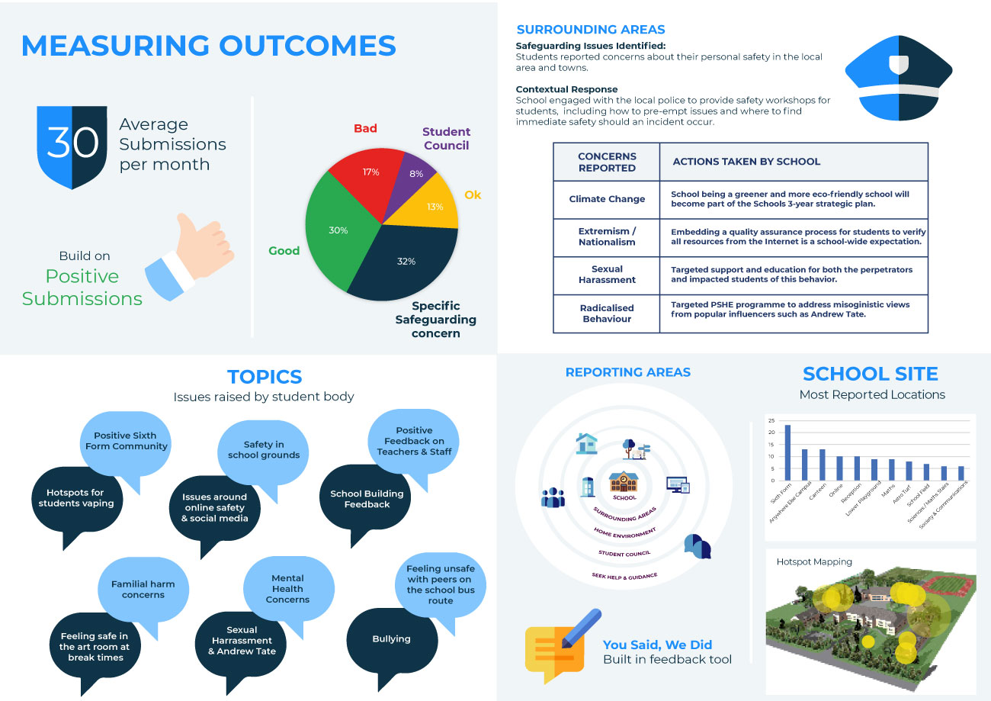
Track and measure the success of your interventions

Slide 17
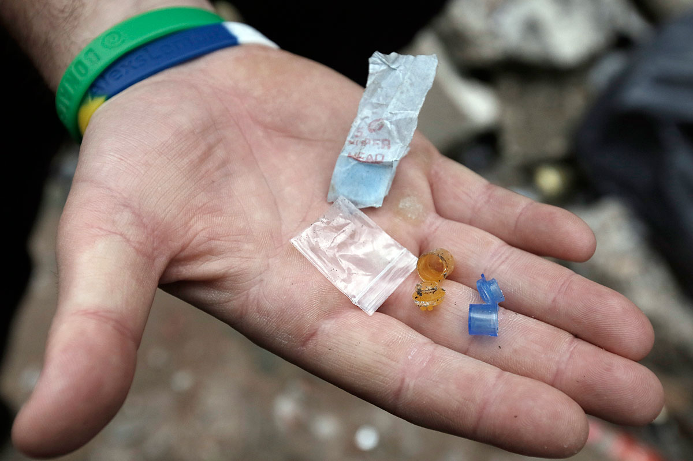
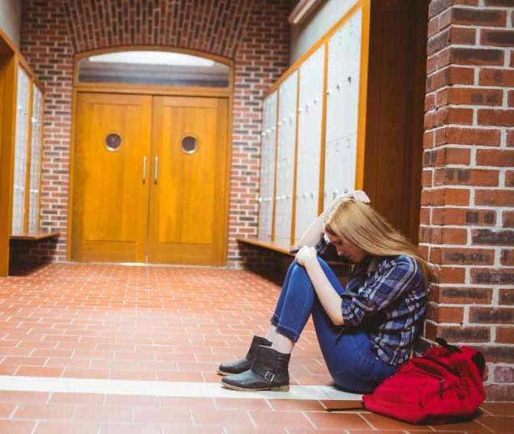
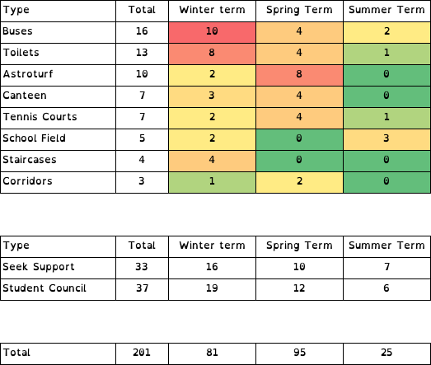
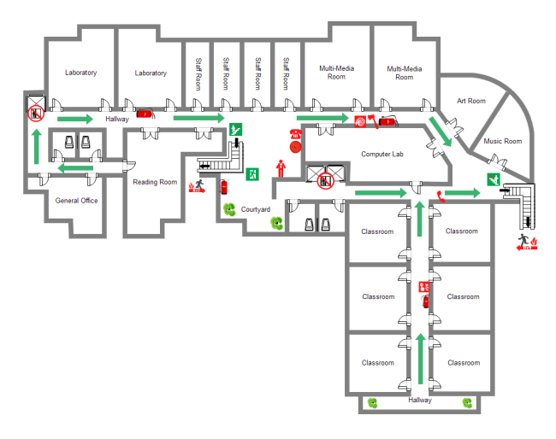



The Student Voice in action
County Lines
Mental
Health
Tracking Impact
Community Safeguarding
Domestic
Abuse
Building Design
Notes:
Primary school - (Mental Health)
Secondary - (Domestic Abuse case)
Bilton (county lines)– worked with police to intercept drug taking in local parks and police visits to school to speak with students
RFS (building design) – changed layout of school to address and reduce behaviour issues and disruption during the school day
Kineton (heatmap table) – Heatmapping of school areas throughout the year specifically targeting Harmful Sexual Behaviour. Noticed in the spring term when they shut the field, issues arose in other areas that they could put interventions in place for. The work they are able to do using the data has addressed HSB and is changing the school culture.
Mcdonalds (community safeguarding) – primary working with local Mcdonalds to provide safeguarding training.

Slide 18
In Summary - Our Solution
🌟Consolidate pupil voice:
Capture consistent and engaged pupil voice in one place with features to close the feedback loop and build trust 🌟Help stop firefighting:
Gather proactive insight into where and when issues are happening to build more targeted, preventative interventions 🌟Support you to be inspection ready:
Level up student voice in your inspections with strong evidencing of how you develop positive outcomes at pupil, school and Trust/Authority level 🌟Reach vulnerable pupils faster:
Removing barriers for young people to come forward that you would not usually hear from through a proven method

Slide 19
Authentic student voice can develop more meaningful contextual responses
Can enabling student voices through a child’s formal education ultimately benefit future communities and societies?

Slide 20
Thank you
We welcome your questions

